Slide 1

Deep Learning and Computer Vision

Slide 2
Computer Vision with Python
Section Topics and Goals
High Level Overview of Machine Learning
Overview of understanding classification metrics.
Cover Deep Learning Basics

Slide 3
Computer Vision with Python
Section Topics and Goals
Keras Basics
MNIST Data Overview
Convolutional Neural Network Theory
Keras CNN

Slide 4
Computer Vision with Python
Section Topics and Goals
Deep Learning on Custom Image Files
Understanding YOLO v3
YOLO v3 with Python

Slide 5
Machine Learning Overview

Slide 6
Computer Vision with Python
Before we dive into Deep Learning, let’s work on understanding the general machine learning process we will be using.
The specific case of machine learning we will be conducting is known as supervised learning

Slide 7
Machine Learning
Because different students have different backgrounds in math, we will keep the mathematics behind the machine learning algorithms light.

Slide 8
Machine Learning
A great textbook on general machine learning is Introduction to Statistical Learning by Gareth James as a companion book.
It’s freely available online. Simply google search the title of the book.

Slide 9
What is Machine Learning?
Machine learning is a method of data analysis that automates analytical model building.
Using algorithms that iteratively learn from data, machine learning allows computers to find hidden insights without being explicitly programmed where to look.

Slide 10
What is it used for?
Fraud detection.
Web search results.
Real-time ads on web pages
Credit scoring and next-best offers.
Prediction of equipment failures.
New pricing models.
Network intrusion detection.
Recommendation Engines
Customer Segmentation
Text Sentiment Analysis
Predicting Customer Churn
Pattern and image recognition.
Email spam filtering.
Financial Modeling

Slide 11
Supervised Learning
Supervised learning algorithms are trained using labeled examples, such as an input where the desired output is known.
For example, a picture could have a category label, such as either Dog or Cat.

Slide 12
Supervised Learning
The learning algorithm receives a set of inputs along with the corresponding correct outputs, and the algorithm learns by comparing its actual output with correct outputs to find errors.
It then modifies the model accordingly.

Slide 13
Supervised Learning
Supervised learning is commonly used in applications where historical data predicts likely future events.

Slide 14
Machine Learning Process
Test
Data
Model
Training &
Building
Data
Acquisition
Data
Cleaning
Model
Testing
Model
Deployment

Slide 15
Machine Learning Process
Get your data! Customers, Sensors, etc...
Data
Acquisition

Slide 16
Machine Learning Process
Clean and format your data (using Keras)
Data
Acquisition
Data
Cleaning

Slide 17
Machine Learning Process
Test
Data
Training
Data
Data
Acquisition
Data
Cleaning

Slide 18
Machine Learning Process
Test
Data
Model
Training &
Building
Data
Acquisition
Data
Cleaning

Slide 19
Machine Learning Process
Test
Data
Model
Training &
Building
Data
Acquisition
Data
Cleaning
Model
Testing

Slide 20
Machine Learning Process
Test
Data
Model
Training &
Building
Data
Acquisition
Data
Cleaning
Model
Testing

Slide 21
Machine Learning Process
Test
Data
Model
Training &
Building
Data
Acquisition
Data
Cleaning
Model
Testing
Model
Deployment

Slide 22
Supervised Learning
Image classification and recognition is a very common and widely applicable use of deep learning and machine learning with OpenCV and Keras.
Let’s continue by learning about how to evaluate a classification task.

Slide 23
Classification Metrics

Slide 24
Model Evaluation
We just learned that after our machine learning process is complete, we will use performance metrics to evaluate how our model did.
Let’s discuss classification metrics in more detail!

Slide 25
Model Evaluation
The key classification metrics we need to understand are:
Accuracy
Recall
Precision
F1-Score

Slide 26
Model Evaluation
But first, we should understand the reasoning behind these metrics and how they will actually work in the real world!

Slide 27
Model Evaluation
Typically in any classification task your model can only achieve two results:
Either your model was correct in its prediction.
Or your model was incorrect in its prediction.

Slide 28
Model Evaluation
Fortunately incorrect vs correct expands to situations where you have multiple classes.
For the purposes of explaining the metrics, let’s imagine a binary classification situation, where we only have two available classes.

Slide 29
Model Evaluation
In our example, we will attempt to predict if an image is a dog or a cat.
Since this is supervised learning, we will first fit/train a model on training data, then test the model on testing data.
Once we have the model’s predictions from the X_test data, we compare it to the true y values (the correct labels).

Slide 30
Model Evaluation
TRAINED
MODEL

Slide 31
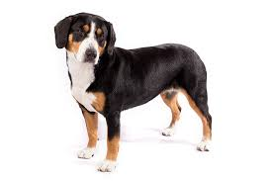
Model Evaluation
TRAINED
MODEL
Test Image
from X_test

Slide 32
Model Evaluation
TRAINED
MODEL
Test Image
from X_test
DOG
Correct Label
from y_test

Slide 33
Model Evaluation
TRAINED
MODEL
Test Image
from X_test
DOG
Prediction on
Test Image
DOG
Correct Label
from y_test

Slide 34
Model Evaluation
TRAINED
MODEL
Test Image
from X_test
DOG
Prediction on
Test Image
DOG
Correct Label
from y_test
DOG == DOG ?
Compare Prediction to Correct Label

Slide 35
Model Evaluation
TRAINED
MODEL
Test Image
from X_test
CAT
Prediction on
Test Image
DOG
Correct Label
from y_test
DOG == CAT ?
Compare Prediction to Correct Label

Slide 36
Model Evaluation
We repeat this process for all the images in our X test data.
At the end we will have a count of correct matches and a count of incorrect matches.
The key realization we need to make, is that in the real world, not all incorrect or correct matches hold equal value!

Slide 37
Model Evaluation
We repeat this process for all the images in our X test data.
At the end we will have a count of correct matches and a count of incorrect matches.
The key realization we need to make, is that in the real world, not all incorrect or correct matches hold equal value!

Slide 38
Model Evaluation
Also in the real world, a single metric won’t tell the complete story!
To understand all of this, let’s bring back the 4 metrics we mentioned and see how they are calculated.
We could organize our predicted values compared to the real values in a confusion matrix.

Slide 39
Model Evaluation
Also in the real world, a single metric won’t tell the complete story!
To understand all of this, let’s bring back the 4 metrics we mentioned and see how they are calculated.
We could organize our predicted values compared to the real values in a confusion matrix.

Slide 40
Model Evaluation
Accuracy
Accuracy in classification problems is the number of correct predictions made by the model divided by the total number of predictions.

Slide 41
Model Evaluation
Accuracy
For example, if the X_test set was 100 images and our model correctly predicted 80 images, then we have 80/100.
0.8 or 80% accuracy.

Slide 42
Model Evaluation
Accuracy
Accuracy is useful when target classes are well balanced
In our example, we would have roughly the same amount of cat images as we have dog images.

Slide 43
Model Evaluation
Accuracy
Accuracy is not a good choice with unbalanced classes!
Imagine we had 99 images of dogs and 1 image of a cat.
If our model was simply a line that always predicted dog we would get 99% accuracy!

Slide 44
Model Evaluation
Accuracy
Imagine we had 99 images of dogs and 1 image of a cat.
If our model was simply a line that always predicted dog we would get 99% accuracy!
In this situation we’ll want to understand recall and precision

Slide 45
Model Evaluation
Recall
Ability of a model to find all the relevant cases within a dataset.
The precise definition of recall is the number of true positives divided by the number of true positives plus the number of false negatives.

Slide 46
Model Evaluation
Recall
Ability of a model to find all the relevant cases within a dataset.
The precise definition of recall is the number of true positives divided by the number of true positives plus the number of false negatives.

Slide 47
Model Evaluation
Precision
Ability of a classification model to identify only the relevant data points.
Precision is defined as the number of true positives divided by the number of true positives plus the number of false positives.

Slide 48
Model Evaluation
Recall and Precision
Often you have a trade-off between Recall and Precision.
While recall expresses the ability to find all relevant instances in a dataset, precision expresses the proportion of the data points our model says was relevant actually were relevant.

Slide 49
Model Evaluation
F1-Score
In cases where we want to find an optimal blend of precision and recall we can combine the two metrics using what is called the F1 score.

Slide 50
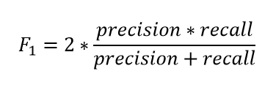
Model Evaluation
F1-Score
The F1 score is the harmonic mean of precision and recall taking both metrics into account in the following equation:

Slide 51
Model Evaluation
F1-Score
We use the harmonic mean instead of a simple average because it punishes extreme values.
A classifier with a precision of 1.0 and a recall of 0.0 has a simple average of 0.5 but an F1 score of 0.

Slide 52
Model Evaluation
We can also view all out correctly classified versus incorrectly classified images in the form of a confusion matrix.

Slide 53
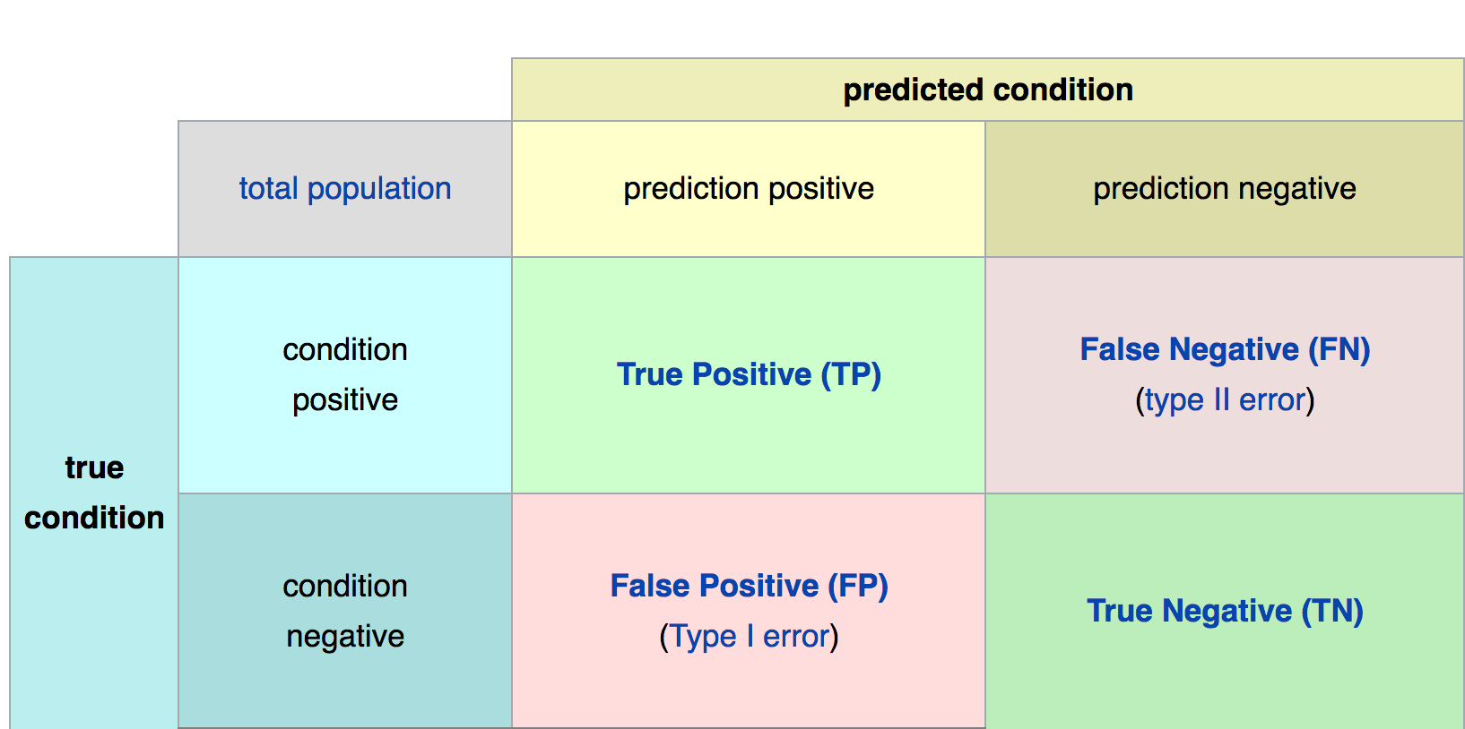
Confusion Matrix
Math &
Statistics
Machine Learning
DS
Software
Research
Domain
Knowledge

Slide 54
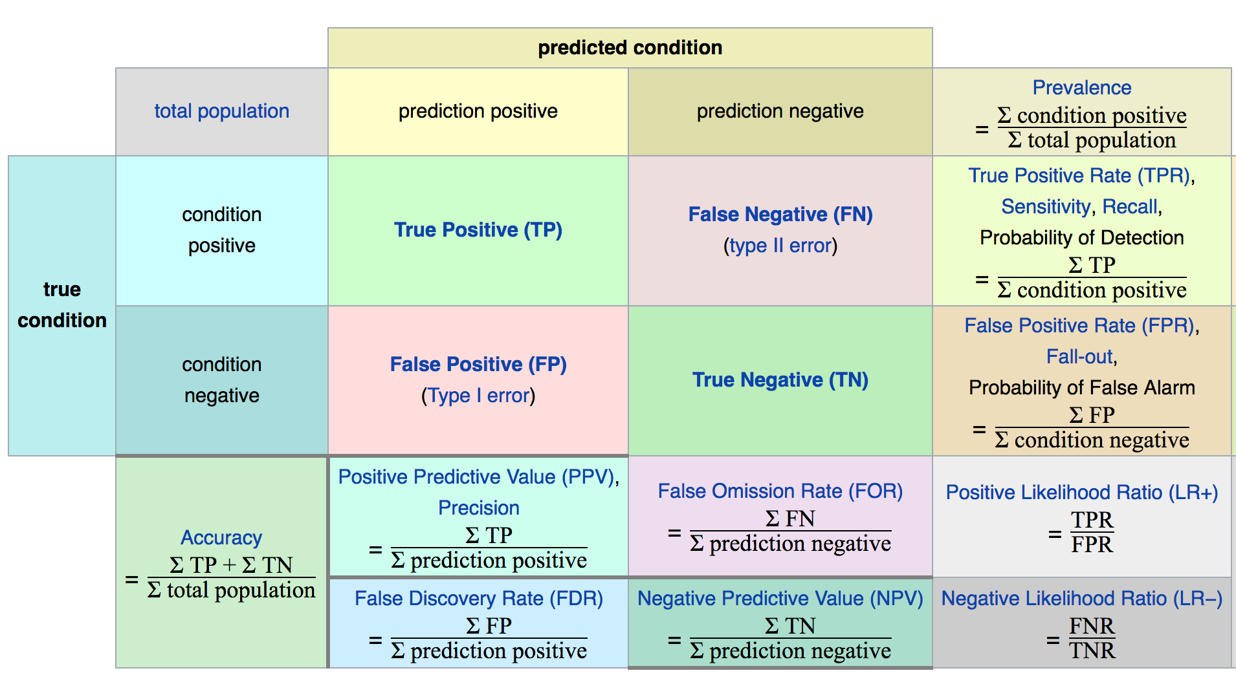
Confusion Matrix
Math &
Statistics
Machine Learning
DS
Software
Research
Domain
Knowledge

Slide 55
Model Evaluation
The main point to remember with the confusion matrix and the various calculated metrics is that they are all fundamentally ways of comparing the predicted values versus the true values.
What constitutes “good” metrics, will really depend on the specific situation!
Math &
Statistics
Machine Learning
DS
Software
Research
Domain
Knowledge

Slide 56
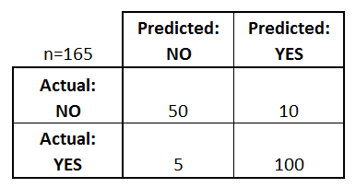
Model Evaluation
We can use a confusion matrix to evaluate our model.
For example, imagine testing for disease.
Math &
Statistics
Machine Learning
Example: Test for presence of disease
NO = negative test = False = 0
YES = positive test = True = 1
DS
Software
Research
Domain
Knowledge

Slide 57
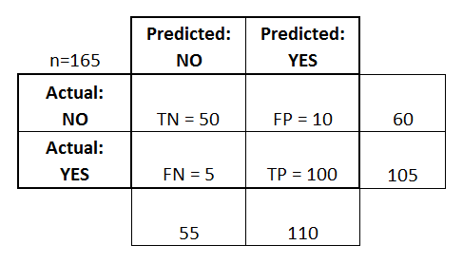
Confusion Matrix
Basic Terminology:
True Positives (TP)
True Negatives (TN)
False Positives (FP)
False Negatives (FN)
Math &
Statistics
Machine Learning
DS
Software
Research
Domain
Knowledge

Slide 58
Confusion Matrix
Math &
Statistics
Machine Learning
Accuracy:
Overall, how often is it correct?
(TP + TN) / total = 150/165 = 0.91
DS
Software
Research
Domain
Knowledge

Slide 59
Confusion Matrix
Misclassification Rate (Error Rate):
Overall, how often is it wrong?
(FP + FN) / total = 15/165 = 0.09
Math &
Statistics
Machine Learning
DS
Software
Research
Domain
Knowledge

Slide 60
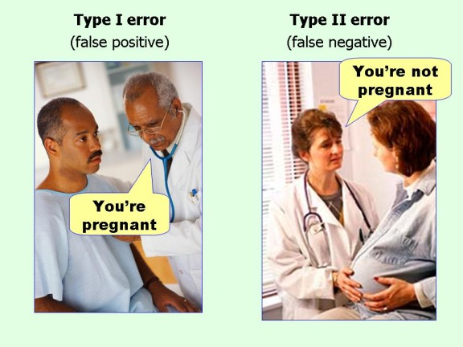
Confusion Matrix
Math &
Statistics
Machine Learning
DS
Software
Research
Domain
Knowledge

Slide 61
Model Evaluation
Still confused on the confusion matrix?
No problem! Check out the Wikipedia page for it, it has a really good diagram with all the formulas for all the metrics.
Throughout the training, we’ll usually just print out metrics (e.g. accuracy).
Math &
Statistics
Machine Learning
DS
Software
Research
Domain
Knowledge

Slide 62
Classification Metrics

Slide 63
Computer Vision with Python
We just learned that after our machine learning process is complete, we will use performance metrics to evaluate how our model did.
Let’s discuss classification metrics in more detail!

Slide 64
Computer Vision with Python
The key classification metrics we need to understand are:
Accuracy
Recall
Precision
F1-Score

Slide 65
Computer Vision with Python
But first, we should understand the reasoning behind these metrics and how they will actually work in the real world!

Slide 66
Computer Vision with Python
Typically in any classification task your model can only achieve two results:
Either your model was correct in its prediction.
Or your model was incorrect in its prediction.

Slide 67
Computer Vision with Python
Fortunately incorrect vs correct expands to situations where you have multiple classes.
For the purposes of explaining the metrics, let’s image a binary classification situation, where we only have two available classes.

Slide 68
Computer Vision with Python
In our example, we will attempt to predict if an image is a dog or a cat.
Since this is supervised learning, we will first fit/train a model on training data, then test the model on testing data.
Once we have the model’s predictions from the X_test data, we compare it to the true y values (the correct labels).

Slide 69
Computer Vision with Python
TRAINED
MODEL

Slide 70
Computer Vision with Python
TRAINED
MODEL
Test Image
from X_test

Slide 71
Computer Vision with Python
TRAINED
MODEL
Test Image
from X_test
DOG
Correct Label
from y_test

Slide 72
Computer Vision with Python
TRAINED
MODEL
Test Image
from X_test
DOG
Prediction on
Test Image
DOG
Correct Label
from y_test

Slide 73
Computer Vision with Python
TRAINED
MODEL
Test Image
from X_test
DOG
Prediction on
Test Image
DOG
Correct Label
from y_test
DOG == DOG ?
Compare Prediction to Correct Label

Slide 74
Computer Vision with Python
TRAINED
MODEL
Test Image
from X_test
CAT
Prediction on
Test Image
DOG
Correct Label
from y_test
DOG == CAT ?
Compare Prediction to Correct Label

Slide 75
Computer Vision with Python
We repeat this process for all the images in our X test data.
At the end we will have a count of correct matches and a count of incorrect matches.
The key realization we need to make, is that in the real world, not all incorrect or correct matches hold equal value!

Slide 76
Computer Vision with Python
We repeat this process for all the images in our X test data.
At the end we will have a count of correct matches and a count of incorrect matches.
The key realization we need to make, is that in the real world, not all incorrect or correct matches hold equal value!

Slide 77
Computer Vision with Python
Also in the real world, a single metric won’t tell the complete story!
To understand all of this, let’s bring back the 4 metrics we mentioned and see how they are calculated.
We could organize our predicted values compared to the real values in a confusion matrix.

Slide 78
Computer Vision with Python
Also in the real world, a single metric won’t tell the complete story!
To understand all of this, let’s bring back the 4 metrics we mentioned and see how they are calculated.
We could organize our predicted values compared to the real values in a confusion matrix.

Slide 79
Computer Vision with Python
Accuracy
Accuracy in classification problems is the number of correct predictions made by the model divided by the total number of predictions.

Slide 80
Computer Vision with Python
Accuracy
For example, if the X_test set was 100 images and our model correctly predicted 80 images, then we have 80/100.
0.8 or 80% accuracy.

Slide 81
Computer Vision with Python
Accuracy
Accuracy is useful when target classes are well balanced
In our example, we would have roughly the same amount of cat images as we have dog images.

Slide 82
Computer Vision with Python
Accuracy
Accuracy is not a good choice with unbalanced classes!
Imagine we had 99 images of dogs and 1 image of a cat.
If our model was simply a line that always predicted dog we would get 99% accuracy!

Slide 83
Computer Vision with Python
Accuracy
Imagine we had 99 images of dogs and 1 image of a cat.
If our model was simply a line that always predicted dog we would get 99% accuracy!
In this situation we’ll want to understand recall and precision

Slide 84
Computer Vision with Python
Recall
Imagine we had 99 images of dogs and 1 image of a cat.
If our model was simply a line that always predicted dog we would get 99% accuracy!
In this situation we’ll want to understand recall and precision

Slide 85
Introduction to
Deep Learning

Slide 86
Deep Learning
We now know enough terminology and theory to begin working with Keras!
We’ll be using a data set of image features of counterfeit versus real bills.
Later on we will learn about convolutional neural networks for handling image data directly!

Slide 87
Deep Learning
The next series of lectures will cover:
Neurons
Neural Networks
Cost Functions
Gradient Descent and BackPropagation

Slide 88
Deep Learning
Keep in mind, Keras will do all of this work for us on the back end with just a few simple line calls, but it's important to have an intuition for what is happening behind the scenes!

Slide 89
Deep Learning
Let’s get started, keep in mind, the next series of lectures is just intuition and theory.
We’ll start coding in the Keras Basics lecture!

Slide 90
Deep Learning
Before we launch straight into neural networks, we need to understand the individual components first, such as a single “neuron”.

Slide 91
Deep Learning
Artificial Neural Networks (ANN) actually have a basis in biology!
Let’s see how we can attempt to mimic biological neurons with an artificial neuron, known as a perceptron!

Slide 92
Deep Learning
The biological neuron:
Dendrites
Body
Axon

Slide 93
Deep Learning
The artificial neuron also has inputs and outputs!
Input 0
Output
Input 1

Slide 94
Deep Learning
This simple model is known as a perceptron.
Input 0
Output
Input 1

Slide 95
Deep Learning
Simple example of how it can work.
Input 0
Output
Input 1

Slide 96
Deep Learning
We have two inputs and an output
Input 0
Output
Input 1

Slide 97
Deep Learning
Inputs will be values of features
12
Input 0
Output
4
Input 1

Slide 98
Deep Learning
Inputs are multiplied by a weight
12
Weight 0
Input 0
Output
Weight 1
4
Input 1

Slide 99
Deep Learning
Weights initially start off as random
12
Weight 0
Input 0
Output
Weight 1
4
Input 1

Slide 100
Deep Learning
Weights initially start off as random
12
Input 0
0.5
Output
-1
4
Input 1

Slide 101
Deep Learning
Inputs are now multiplied by weights
12
Input 0
0.5
Output
-1
4
Input 1

Slide 102
Deep Learning
Inputs are now multiplied by weights
Input 0
12 * 0.5 = 6
Output
4 * -1 = -4
Input 1

Slide 103
Deep Learning
Then these results are passed to an activation function.
Input 0
12 * 0.5 = 6
Activation
Function
Output
4 * -1 = -4
Input 1

Slide 104
Deep Learning
Many activation functions to choose from, we’ll cover this in more detail later!
Input 0
12 * 0.5 = 6
Activation
Function
Output
4 * -1 = -4
Input 1

Slide 105
Deep Learning
For now our activation function will be very simple...
Input 0
12 * 0.5 = 6
Activation
Function
Output
4 * -1 = -4
Input 1

Slide 106
Deep Learning
If sum of inputs is positive return 1, if sum is negative output 0.
Input 0
12 * 0.5 = 6
Activation
Function
Output
4 * -1 = -4
Input 1

Slide 107
Deep Learning
In this case 6-4=2 so the activation function returns 1.
Input 0
12 * 0.5 = 6
Activation
Function
1
Output
4 * -1 = -4
Input 1

Slide 108
Deep Learning
There is a possible issue. What if the original inputs started off as zero?
Input 0
12 * 0.5 = 6
Activation
Function
1
Output
4 * -1 = -4
Input 1

Slide 109
Deep Learning
Then any weight multiplied by the input would still result in zero!
Input 0
12 * 0.5 = 6
Activation
Function
1
Output
4 * -1 = -4
Input 1

Slide 110
Deep Learning
We fix this by adding in a bias term, in this case we choose 1.
Input 0
12 * 0.5 = 6
Activation
Function
1
4 * -1 = -4
Output
Input 1
+ 1
Bias

Slide 111
Deep Learning
So what does this look like mathematically?
Input 0
12 * 0.5 = 6
Activation
Function
1
4 * -1 = -4
Output
Input 1
+ 1
Bias

Slide 112
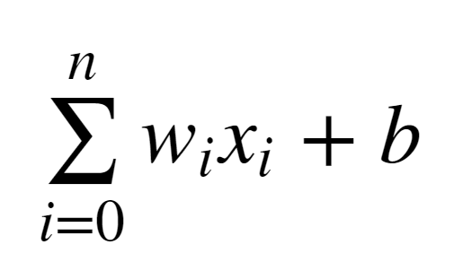
Deep Learning
Let’s quickly think about how we can represent this perceptron model mathematically:

Slide 113
Deep Learning
Once we have many perceptrons in a network we’ll see how we can easily extend this to a matrix form!

Slide 114
Deep Learning
Review
Biological Neuron
Perceptron Model
Mathematical Representation

Slide 115
Introduction to
Neural Networks

Slide 116
Deep Learning
We’ve seen how a single perceptron behaves, now let’s expand this concept to the idea of a neural network!
Let’s see how to connect many perceptrons together and then how to represent this mathematically!

Slide 117
Deep Learning
Multiple Perceptrons Network

Slide 118
Deep Learning
Input Layer. 2 hidden layers. Output Layer

Slide 119
Deep Learning
Input Layers
Real values from the data
Hidden Layers
Layers in between input and output
3 or more layers is “deep network”
Output Layer
Final estimate of the output

Slide 120
Deep Learning
As you go forwards through more layers, the level of abstraction increases.
Let’s now discuss the activation function in a little more detail!

Slide 121
Deep Learning
Previously our activation function was just a simple function that output 0 or 1.
1
Output
0
0
z = wx + b

Slide 122
Deep Learning
This is a pretty dramatic function, since small changes aren’t reflected.
1
Output
0
0
z = wx + b

Slide 123
Deep Learning
It would be nice if we could have a more dynamic function, for example the red line!
1
Output
0
0
z = wx + b

Slide 124
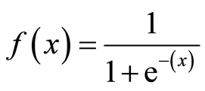
Deep Learning
Lucky for us, this is the sigmoid function!
1
Output
0
0
z = wx + b

Slide 125
Deep Learning
Changing the activation function used can be beneficial depending on the task!
1
Output
0
0
z = wx + b

Slide 126
Deep Learning
Let’s discuss a few more activation functions that we’ll encounter!
1
Output
0
0
z = wx + b

Slide 127
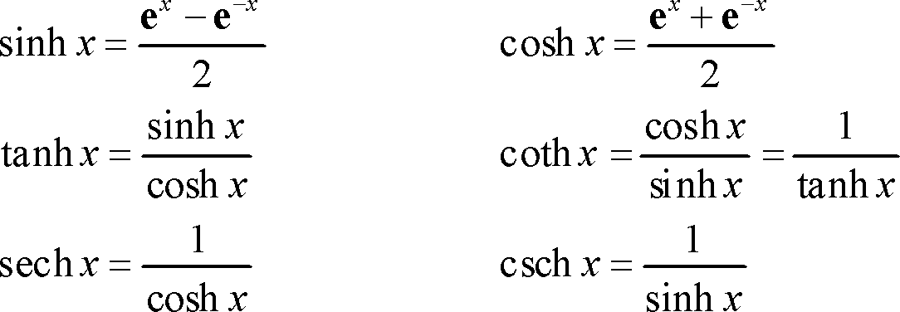
Deep Learning
Hyperbolic Tangent: tanh(z)
1
Output
-1
0
z = wx + b

Slide 128
Deep Learning
Rectified Linear Unit (ReLU): This is actually a relatively simple function: max(0,z)
Output
0
z = wx + b

Slide 129
Deep Learning
ReLu and tanh tend to have the best performance, so we will focus on these two.
Deep Learning libraries have these built in for us, so we don’t need to worry about having to implement them manually!

Slide 130
Deep Learning
As we continue on, we’ll also talk about some more state of the art activation functions.
Up next, we’ll discuss cost functions, which will allow us to measure how well these neurons are performing!

Slide 131
Cost Functions

Slide 132
Deep Learning
Let’s now explore how we can evaluate performance of a neuron!
We can use a cost function to measure how far off we are from the expected value.

Slide 133
Deep Learning
We’ll use the following variables:
y to represent the true value
a to represent neuron’s prediction
In terms of weights and bias:
w*x + b = z
Pass z into activation function σ(z) = a

Slide 134
Deep Learning
Quadratic Cost
C = Σ(y-a)² / n
We can see that larger errors are more prominent due to the squaring.
Unfortunately this calculation can cause a slowdown in our learning speed.

Slide 135
Deep Learning
Cross Entropy
C = (-1/n) Σ (y⋅ln(a) + (1-y)⋅ln(1-a)
This cost function allows for faster learning.
The larger the difference, the faster the neuron can learn.

Slide 136
Deep Learning
We now have 2 key aspects of learning with neural networks, the neurons with their activation function and the cost function.
We’re still missing a key step, actually “learning”!

Slide 137
Deep Learning
We need to figure out how we can use our neurons and the measurement of error (our cost function) and then attempt to correct our prediction, in other words, “learn”!

Slide 138
Deep Learning
In the next lecture we’ll briefly cover how we can do this with Gradient Descent!

Slide 139
Gradient Descent
and Backpropagation

Slide 140
Deep Learning
If you’ve dabbled in machine learning before, you may have already heard of Gradient Descent!
Let’s quickly go over it with a high level overview!

Slide 141
Deep Learning
Gradient descent is an optimization algorithm for finding the minimum of a function.
To find a local minimum, we take steps proportional to the negative of the gradient.

Slide 142
Deep Learning
Gradient Descent (in 1 dimension)
C
w

Slide 143
Deep Learning
Gradient Descent (in 1 dimension)
C
w

Slide 144
Deep Learning
Gradient Descent (in 1 dimension)
C
w

Slide 145
Deep Learning
Gradient Descent (in 1 dimension)
C
w

Slide 146
Deep Learning
Visually we can see what parameter value to choose to minimize our Cost!
C
w

Slide 147
Deep Learning
Finding this minimum is simple for 1 dimension, but our cases will have many more parameters, meaning we’ll need to use the built-in linear algebra that our Deep Learning library will provide!

Slide 148
Deep Learning
Using gradient descent we can figure out the best parameters for minimizing our cost, for example, finding the best values for the weights of the neuron inputs.

Slide 149
Deep Learning
We now just have one issue to solve, how can we quickly adjust the optimal parameters or weights across our entire network?
This is where backpropagation comes in!

Slide 150
Deep Learning
Backpropagation is used to calculate the error contribution of each neuron after a batch of data is processed.
It relies heavily on the chain rule to go back through the network and calculate these errors.

Slide 151
Deep Learning
Backpropagation works by calculating the error at the output and then distributes back through the network layers.
It requires a known desired output for each input value (supervised learning).

Slide 152
Deep Learning
The implementation of backpropagation will be further clarified when we dive into the math example!
For now let’s finish off our high level discussion with TensorFlow’s playground!

Slide 153
Convolutional Neural Networks

Slide 154
Deep Learning
We just created a Neural Network for already defined features.
But what if we have the raw image data?
We need to learn about Convolutional Neural Networks in order to effectively solve the problems that image data can present!

Slide 155
Deep Learning
Now let’s explore how to implement a CNN with Keras!

Slide 156
Convolutional
Neural Networks

Slide 157
Deep Learning
We just solved the MNIST task with a very simple linear approach.
Let’s explore a much better approach using Convolutional Neural Network.

Slide 158
Deep Learning
Just like the simple perceptron, CNNs also have their origins in biological research.
Hubel and Wiesel studied the structure of the visual cortex in mammals, winning a Nobel Prize in 1981.

Slide 159
Deep Learning
Their research revealed that neurons in the visual cortex had a small local receptive field.

Slide 160
Deep Learning
This idea then inspired an ANN architecture that would become CNN
Famously implemented in the 1998 paper by Yann LeCun et al.
The LeNet-5 architecture was first used to classify the MNIST data set.

Slide 161
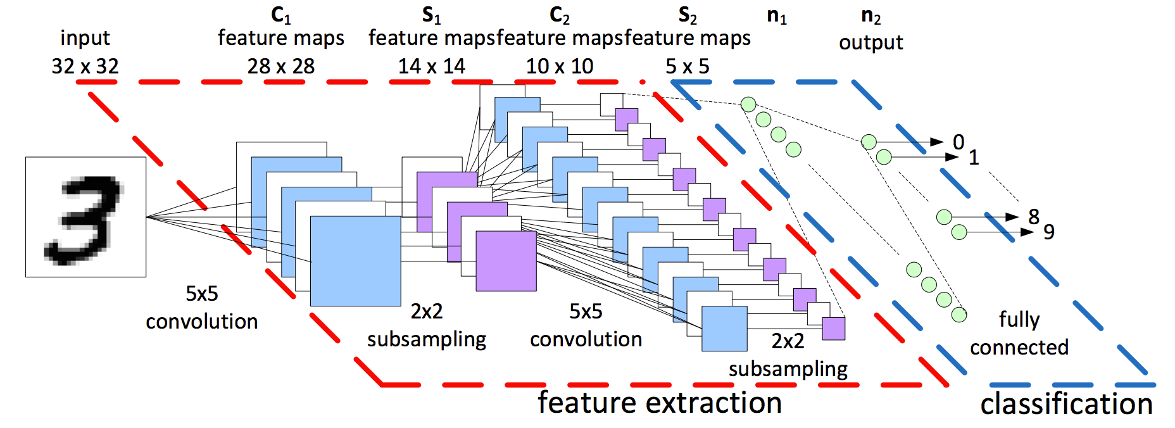
Deep Learning
When learning about CNNs you’ll often see a diagram like this:

Slide 162
Deep Learning
Let’s break down the various aspects of a CNN seen here:

Slide 163
Deep Learning
Tensors
DNN vs CNN
Convolutions and Filters
Padding
Pooling Layers
Review Dropout

Slide 164
Deep Learning
Recall that Tensors are N-Dimensional Arrays that we build up to:
Scalar - 3
Vector - [3,4,5]
Matrix - [ [3,4] , [5,6] , [7,8] ]
Tensor - [[ [ 1, 2] , [ 3, 4] ],
[[ 5, 6] , [ 7, 8]]]

Slide 165
Deep Learning
Tensors make it very convenient to feed in sets of images into our model - (I,H,W,C)
I : Images
H: Height of Image in Pixels
W: Width of Image in Pixels
C: Color Channels: 1-Grayscale, 3-RGB

Slide 166
Deep Learning
Now let’s explore the difference between a Densely Connected Neural Network and a Convolutional Neural Network.
Recall that we’ve already been able to create DNNs with tf.estimator API.

Slide 167
Deep Learning
Densely Connected layer

Slide 168
Deep Learning
Convolutional Layer

Slide 169
Deep Learning
Each unit is connected to a smaller number of nearby units in next layer.

Slide 170
Deep Learning
So why bother with a CNN instead of a DNN?

Slide 171
Deep Learning
The MNIST dataset was 28 by 28 pixels (784 total)
But most images are at least 256 by 256 or greater, (<56k total)!
This leads to too many parameters, unscalable to new images.

Slide 172
Deep Learning
Convolutions also have a major advantage for image processing, where pixels nearby to each other are much more correlated to each other for image detection.

Slide 173
Deep Learning
Each CNN layer looks at an increasingly larger part of the image.
Having units only connected to nearby units also aids in invariance.
CNN also helps with regularization, limiting the search of weights to the size of the convolution.

Slide 174
Deep Learning
Let’s explore how the convolutional neural network relates to image recognition!
We start with the input layer, the image itself.

Slide 175
Deep Learning
Convolutional layers are only connected to pixels in their respective fields.
Convolutional Layer 1
Input Layer

Slide 176
Deep Learning
Convolutional layers are only connected to pixels in their respective fields.
Convolutional Layer 2
Convolutional Layer 1
Input Layer

Slide 177
Deep Learning
We run into a possible issue for edge neurons! There may not be an input there for them.

Slide 178
Deep Learning
We can fix this by adding a “padding” of zeros around the image.

Slide 179
Deep Learning
Let’s walk through 1-D Convolution in more detail, then expand this idea to 2-D Convolution.
Let’s revisit our DNN and convert it to a CNN.

Slide 180
Deep Learning
A DNN

Slide 181
Deep Learning
1-D Convolution
w1
w2

Slide 182
Deep Learning
1-D Convolution
We can treat these weights as a filter.
w1
w2

Slide 183
Deep Learning
1-D Convolution
y = w₁x₁ + w₂x₂
If (w_{1,}w₂) = (1,-1) Then y = x₁ - x₂
When is y at a maximum?
(x_{1,}x₂) = (1,0)
w1
w2

Slide 184
Deep Learning
1-D Convolution
y = w₁x₁ + w₂x₂
If (w_{1,}w₂) = (1,-1) Then y = x₁ - x₂
When is y at a maximum?
(x_{1,}x₂) = (1,0)
w1
w2
w1
w2
w1
w2

Slide 185
Deep Learning
1-D Convolution
We now have a set of weights that can act as a filter for edge detection!
We can then expand this idea to multiple filters.
w1
w2
w1
w2
w1
w2

Slide 186
Deep Learning
1-D Convolution
Filters: 1
Filter Size: 2
Stride: 2
w1
w2
w1
w2
w1
w2

Slide 187
Deep Learning
1-D Convolution
Filters: 1
Filter Size: 2
Stride: 1 (1 Unit at a time)
w1
w2

Slide 188
Deep Learning
1-D Convolution
Remember that we can add zero padding to include more edge pixels.
w1
w2

Slide 189
Deep Learning
1-D Convolution
Filters: 2
Filter Size: 2
Stride: 1 (1 Unit at a time)

Slide 190
Deep Learning
1-D Convolution
Filters: 4
Filter Size: 2
Stride: 1 (1 Unit at a time)
w1
w2

Slide 191
Deep Learning
1-D Convolution
Each filter is detecting a different feature
w1
w2

Slide 192
Deep Learning
1-D Convolution
Filters: 4
Filter Size: 2
Stride: 1 (1 Unit at a time)

Slide 193
Deep Learning
1-D Convolution
For simplicity, we begin to describe and visualize these sets of neurons as blocks instead

Slide 194
Deep Learning
1-D Convolution
For simplicity, we begin to describe and visualize these sets of neurons as blocks instead
1 x L

Slide 195
Deep Learning
1-D Convolution
For simplicity, we begin to describe and visualize these sets of neurons as blocks instead
# of filters
# of units
1 x L

Slide 196
Deep Learning
Let’s now expand these concepts to 2-D Convolution, since we’ll mainly be dealing with images.

Slide 197
Deep Learning - 2D Convolution
Input Image: (H,W)
# of filters
# of units W
# of units H

Slide 198
Deep Learning - 2D Convolution
Input Image: (H,W)
# of filters
# of units W
# of units H
h
w

Slide 199
Deep Learning - 2D Color Images
Input Image: (H,W,C)
# of filters
# of filters
# of units W
# of units H

Slide 200
Deep Learning- 2D Color Images
Input Image: (H,W,C)
# of filters
# of filters
# of units W
# of units H
h
w
c

Slide 201
Deep Learning
Filters are commonly visualized with grids
0 | 0 | 0 | 0 | 0 | 0
0 | 1 | 1 | 1 | 1 | 0
0 | 1 | -1 | -1 | 1 | 0
0 | 1 | -1 | -1 | 1 | 0
0 | 1 | 1 | 1 | 1 | 0
0 | 0 | 0 | 0 | 0 | 0

Slide 202
Deep Learning
Filters are commonly visualized with grids
0 | 0 | 0 | 0 | 0 | 0
0 | 1 | 1 | 1 | 1 | 0
0 | 1 | -1 | -1 | 1 | 0
0 | 1 | -1 | -1 | 1 | 0
0 | 1 | 1 | 1 | 1 | 0
0 | 0 | 0 | 0 | 0 | 0
0 | 0 | 0
0 | -1 | 1
0 | 1 | -1
3 by 3 Filter

Slide 203
Deep Learning
Filters are commonly visualized with grids
0 | 0 | 0 | 0 | 0 | 0
0 | 1 | 1 | 1 | 1 | 0
0 | 1 | -1 | -1 | 1 | 0
0 | 1 | -1 | -1 | 1 | 0
0 | 1 | 1 | 1 | 1 | 0
0 | 0 | 0 | 0 | 0 | 0
0 | 0 | 0
0 | -1 | 1
0 | 1 | -1
3 by 3 Filter

Slide 204
Deep Learning
Filters are commonly visualized with grids
0 | 0 | 0 | 0 | 0 | 0
0 | 1 | 1 | 1 | 1 | 0
0 | 1 | -1 | -1 | 1 | 0
0 | 1 | -1 | -1 | 1 | 0
0 | 1 | 1 | 1 | 1 | 0
0 | 0 | 0 | 0 | 0 | 0
0 | 0 | 0
0 | -1 | 1
0 | 1 | -1
0×0 | 0×0 | 0×0
0×0 | 1×-1 | 1×1
0×0 | 1×1 | 1×-1
3 by 3 Filter
Multiply by filter weights

Slide 205
Deep Learning
Filters are commonly visualized with grids
0 | 0 | 0 | 0 | 0 | 0
0 | 1 | 1 | 1 | 1 | 0
0 | 1 | -1 | -1 | 1 | 0
0 | 1 | -1 | -1 | 1 | 0
0 | 1 | 1 | 1 | 1 | 0
0 | 0 | 0 | 0 | 0 | 0
0 | 0 | 0
0 | -1 | 1
0 | 1 | -1
0×0 | 0×0 | 0×0
0×0 | 1×-1 | 1×1
0×0 | 1×1 | 1×-1
0 | 0 | 0
0 | -1 | 1
0 | 1 | -1
0
3 by 3 Filter
Multiply by filter weights
Sum the Result

Slide 206
Deep Learning
Stride Distance of 1 Example
0 | 0 | 0 | 0 | 0 | 0
0 | 1 | 1 | 1 | 1 | 0
0 | 1 | -1 | -1 | 1 | 0
0 | 1 | -1 | -1 | 1 | 0
0 | 1 | 1 | 1 | 1 | 0
0 | 0 | 0 | 0 | 0 | 0
0 | 0 | 0
0 | -1 | 1
0 | 1 | -1
3 by 3 Filter

Slide 207
Deep Learning
Stride Distance of 2 Example
0 | 0 | 0 | 0 | 0 | 0
0 | 1 | 1 | 1 | 1 | 0
0 | 1 | -1 | -1 | 1 | 0
0 | 1 | -1 | -1 | 1 | 0
0 | 1 | 1 | 1 | 1 | 0
0 | 0 | 0 | 0 | 0 | 0
0 | 0 | 0
0 | -1 | 1
0 | 1 | -1
3 by 3 Filter

Slide 208
Deep Learning
Representation of Multiple Filters
0 | 0 | 0 | 0 | 0 | 0
0 | 1 | 1 | 1 | 1 | 0
0 | 1 | -1 | -1 | 1 | 0
0 | 1 | -1 | -1 | 1 | 0
0 | 1 | 1 | 1 | 1 | 0
0 | 0 | 0 | 0 | 0 | 0
3 by 3 Convolution

Slide 209
Deep Learning
At the original CNN diagram

Slide 210
Deep Learning
Exactly what we saw here:

Slide 211
Deep Learning
Now it is time to discuss subsampling (pooling)

Slide 212
Convolutional
Neural Networks
Part Two

Slide 213
Deep Learning
Now that we understand convolutional layers, let’s discuss pooling layers.
Pooling layers will subsample the input image, which reduces the memory use and computer load as well as reducing the number of parameters.

Slide 214
Deep Learning
Let’s imagine a layer of pixels in our input image:

Slide 215
Deep Learning
For our MNIST digits set, each pixel had a value representing “darkness”
0 | .2 | 0 | ...
.4 | .3 | 0 | ...
... | ... | ... | ...

Slide 216
Deep Learning
We create a 2 by 2 pool of pixels and evaluate the maximum value.
0 | .2 | 0 | ...
.4 | .3 | 0 | ...
... | ... | ... | ...

Slide 217
Deep Learning
Only the max value makes it to the next layer.
0 | .2 | 0 | ...
.4 | .3 | 0 | ...
... | ... | ... | ...
0.4

Slide 218
Deep Learning
We then move over by a “stride”, in this case, our stride is two.
0 | .2 | 0 | ...
.4 | .3 | 0 | ...
... | ... | ... | ...
0.4
Max

Slide 219
Deep Learning
This pooling layer will end up removing a lot of information, even a small pooling “kernel” of 2 by 2 with a stride of 2 will remove 75% of the input data.

Slide 220
Deep Learning
Another common technique deployed with CNN is called “Dropout”
Dropout can be thought of as a form of regularization to help prevent overfitting.
During training, units are randomly dropped, along with their connections.

Slide 221
Deep Learning
This helps prevent units from “co-adapting” too much.
Let’s also quickly point out some famous CNN architectures!

Slide 222
Deep Learning
LeNet-5 by Yann LeCun
AlexNet by Alex Krizhevsky et al.
GoogLeNet by Szegedy at Google Research
ResNet by Kaiming He et al.
Check out the resource links to the papers discussing these architectures!

Slide 223
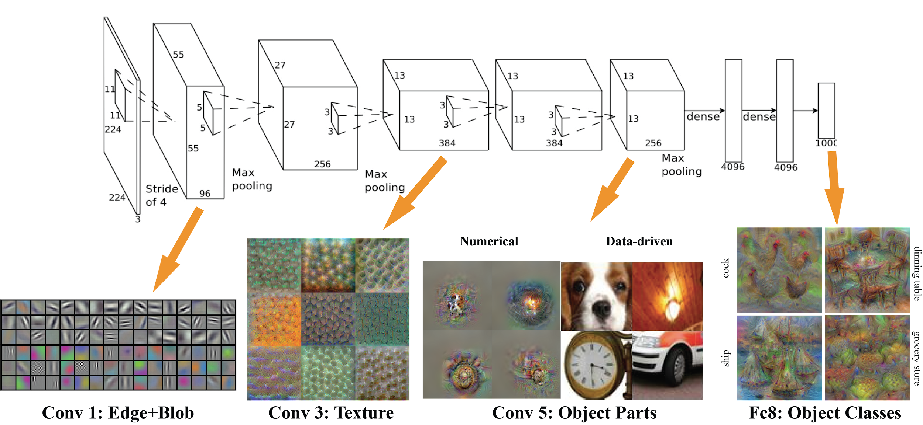
Deep Learning
AlexNet

Slide 224
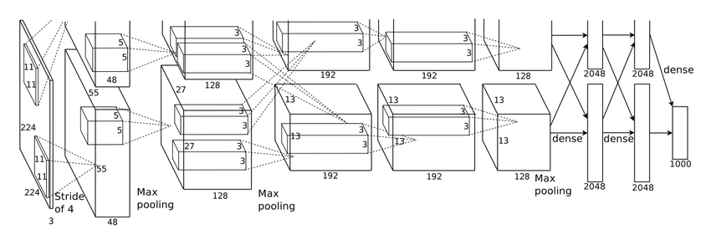
Deep Learning
AlexNet

Slide 225
Deep Learning
Convolutional Neural Network

Slide 226
MNIST Data

Slide 227
Deep Learning
A classic data set in Deep Learning is the MNIST data set.
Let’s quickly cover some basics about it since we’ll be using similar data concepts quite frequently during this section of the course!

Slide 228
Deep Learning
Fortunately this data is easy to access with Keras. The data set has:
60,000 training images
10,000 test images

Slide 229
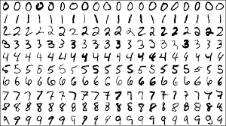
Deep Learning
The MNIST data set contains handwritten single digits from 0 to 9

Slide 230
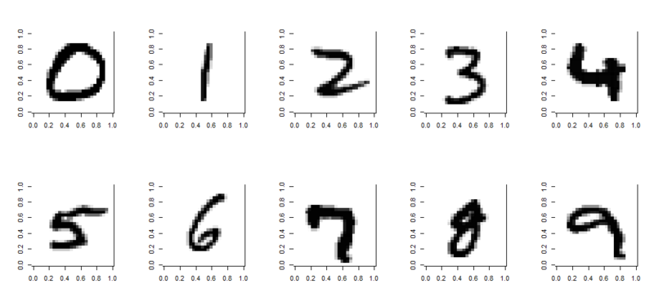
Deep Learning
A single digit image can be represented as an array

Slide 231
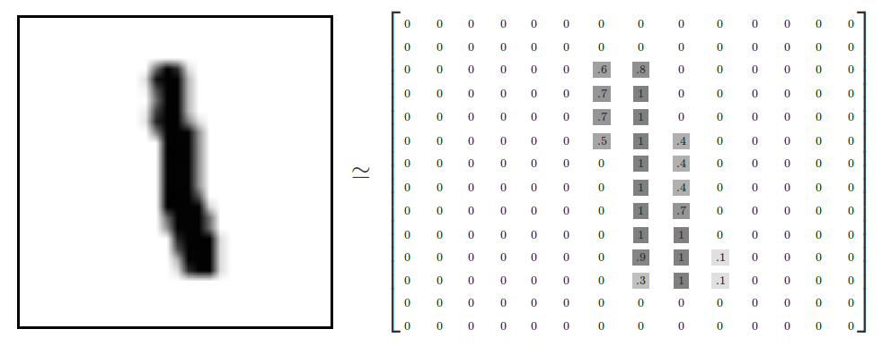
Deep Learning
Specifically, 28 by 28 pixels

Slide 232
Deep Learning
The values represent the grayscale image

Slide 233
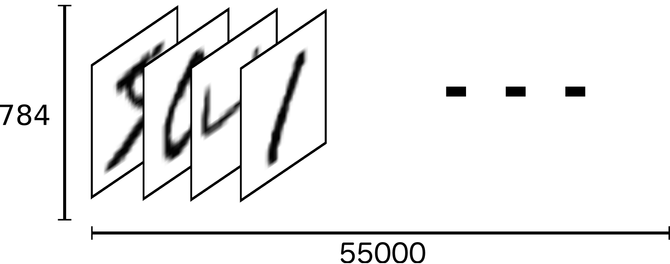
Deep Learning
We can think of the entire group of the 60,000 images as a 4-dimensional array. 60,000 images of 1 chanel 28 by 28 pixels
28
28
60,000

Slide 234
Deep Learning
This array has 4 dimensions
(60000,28,28,1)
(Samples,x,y,channels)
For color images, the last dimension value would be 3 (RGB)

Slide 235
Deep Learning
For the labels we’ll use One-Hot Encoding.
This means that instead of having labels such as “One”, “Two”, etc… we’ll have a single array for each image.

Slide 236
Deep Learning
This means if the original labels of the images are given as a list of numbers
[5,0,4,....,5,6,8]
We will convert them to one-hot encoding (easily done with Keras)

Slide 237
Deep Learning
The label is represented based off the index position in the label array.
The corresponding label will be a 1 at the index location and zero everywhere else.
For example, a drawn digit of 4 would have this label array:
[0,0,0,0,1,0,0,0,0,0]

Slide 238
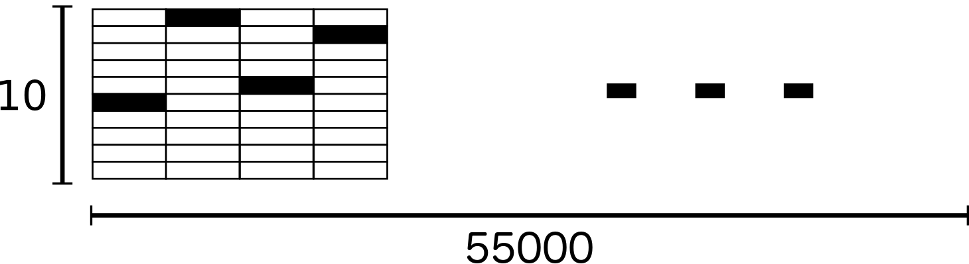
Deep Learning
As a result, the labels for the training data ends up being a large 2-d array (60000,10):
60,000

Slide 239
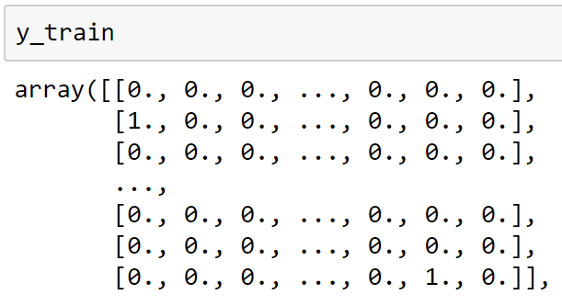
Deep Learning
As a result, the labels for the training data ends up being a large 2-d array (60000,10):

Slide 240
Deep Learning
Now that we understand the MNIST data set and one hot encoding, let’s apply our new knowledge of CNNs with Keras on this data set!

Slide 241
Keras Basics

Slide 242
Computer Vision with Python
Let’s learn how to create a machine learning model with Keras!
We’ll start with some data on currency bank notes.
Some of these bank notes were forgeries and others were legitimate.

Slide 243
Computer Vision with Python
The researchers created a dataset from these bank notes by taking images of the notes and then extracting various numerical features based off the wavelets of the images.

Slide 244
Computer Vision with Python
Very important note!
The data we’re working with in this lecture is not an image.
We’re focusing right now on how to use Keras for general machine learning.

Slide 245
Computer Vision with Python
Once we learn about Convolutional Neural Networks, then we can expand on Keras to feed in image data (pixel images) into a network.
Let’s get started!

Slide 246
Keras CNN with CIFAR-10

Slide 247
Deep Learning on Custom Images
PART TWO

Slide 248
Computer Vision with Python
Note: We will introduce some slightly different imports to reflect the most recent changes to Keras.
These are just a few different imports:
MaxPool2D → MaxPooling2D
Adding in Activation functions separately

Slide 249
Deep Learning for Computer Vision
Assessment Overview

Slide 250
Deep Learning for Computer Vision
Assessment Solution

Slide 251
YOLO Object Detection
Overview

Slide 252
Computer Vision with Python
Let’s learn about the state of the art image detection algorithm known as YOLO (You Only Look Once).
YOLO can view an image and draw bounding boxes over what it perceives as identified classes.

Slide 253
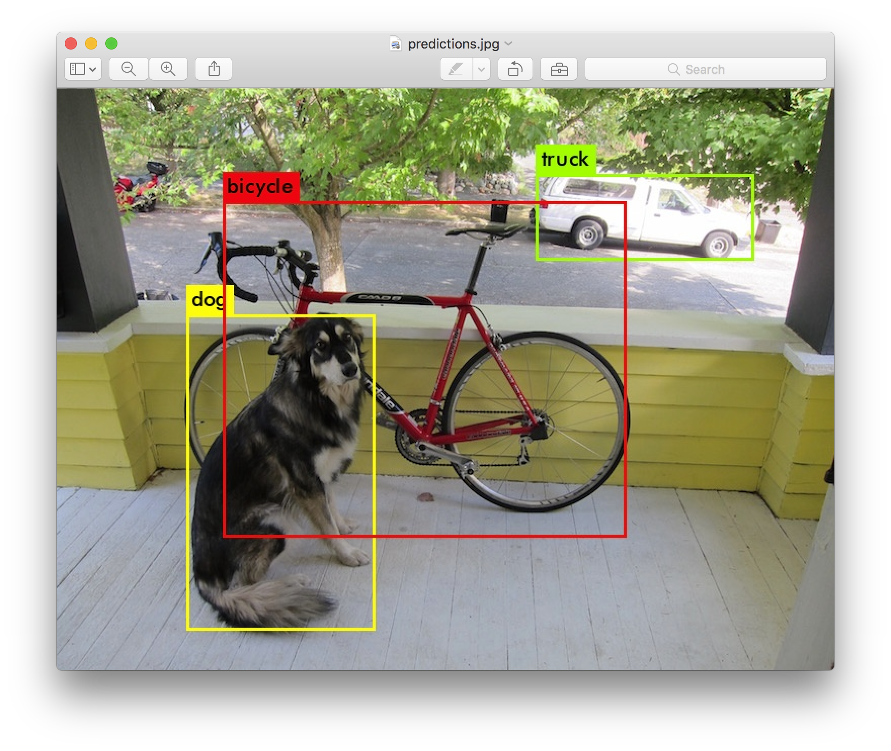
Computer Vision with Python

Slide 254
Computer Vision with Python
In this course we will be using version 3 of the YOLO Object Detection Algorithm, which further improves upon the original implementation in both speed and accuracy!
So what makes YOLO different than other detection algorithms?

Slide 255
Computer Vision with Python
Prior detection systems repurpose classifiers or localizers to perform detection.
They apply the model to an image at multiple locations and scales. High scoring regions of the image are considered detections.

Slide 256
Computer Vision with Python
YOLO uses a totally different approach. We apply a single neural network to the full image. This network divides the image into regions and predicts bounding boxes and probabilities for each region. These bounding boxes are weighted by the predicted probabilities.

Slide 257
Computer Vision with Python
YOLO has several advantages over classifier-based systems.
It looks at the whole image at test time so its predictions are informed by global context in the image.

Slide 258
Computer Vision with Python
It also makes predictions with a single network evaluation unlike systems like R-CNN which require thousands for a single image. This makes it extremely fast, more than 1000x faster than R-CNN and 100x faster than Fast R-CNN.

Slide 259
Computer Vision with Python
In the next lecture we will load an already trained YOLO model and see how we can use it with either image or video data.
We’ve set up an easy to use notebook, you just need to download the model weights file!

Slide 260
Computer Vision with Python
Check out the resource link for the full paper and more information!

Slide 261
YOLO Object Detection
Python Implementation

Slide 262
Computer Vision with Python
Let’s now explore how to implement YOLO v3 with Python.
We will be using an implementation of YOLO v3 that has been trained on the COCO dataset.

Slide 263
Computer Vision with Python
The COCO dataset has over 1.5 million object instances with 80 different object categories.
We will use a pre-trained model that has been trained on the COCO dataset and explore its capabilities.

Slide 264
Computer Vision with Python
Realistically it would take many, many hours of training using a high end GPU to achieve a reasonable model.
Because of this, we will download the weights of the pre-trained network.

Slide 265
Computer Vision with Python
This network is hugely complex, meaning the actual h5 file for the weights is over 200 MB!
Check the resource link in this lecture to download the file (may take some time due to internet)

Slide 266
Computer Vision with Python
Once you’ve downloaded the file, you will need to place it in the DATA directory of the YOLO folder.
Then we have a created a notebook for you with easy to call functions.
Let’s walk you through this process.

Slide 267


